Slide 1
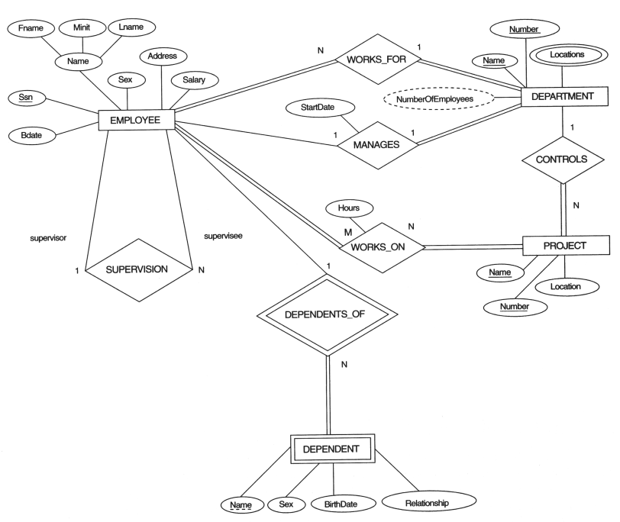
Chapter 7 Concept Data Modeling Using Entities and Relationships
(data model)
ER or OO
Mini-world
Data modeling (DB design)
ER Diagram
(DB structure)
Mini-world
Construct DB
Design DB
Define DB
Load DB
DB
DBMS

Slide 2
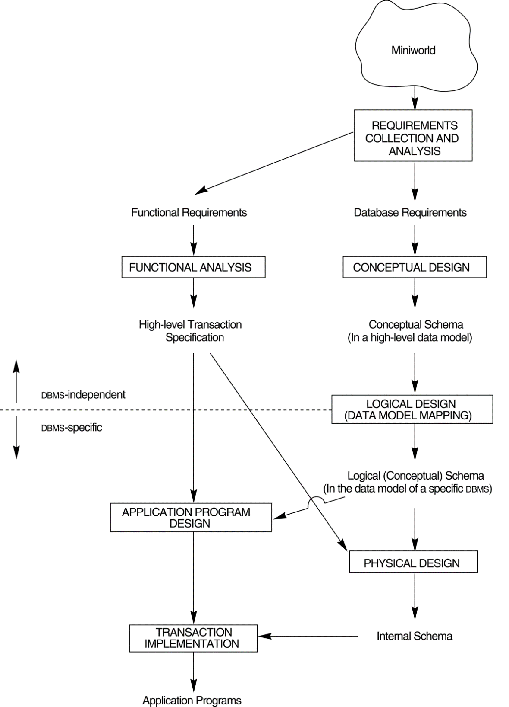
A simplified diagram to illustrate the main phases of database design.
Ch.7
Ch.8
Construct DB
Design DB
Define DB
Load DB
Ch.5
Mini-world
DB
DBMS

Slide 3

Process Models
Flow Chart, Pseudo Code, Sequence Diagram, …
High level:
Process
Model
Java, C, PASCAL, COBOL,…
Implementation:
Assembly, Machine code
Low level:

Slide 4
Process modeling
(process model)
Flow chart, Pseudocode or Sequence diagram
Flow chart
Mini-World
(functional requirements)
Process modeling (Program design)
Sequence diagram

Slide 5
Data Models
A set of concepts for modeling DB structure
High level: ER, OO, UML
Data Model
Implementation: Relational
Low level: DB command

Slide 6

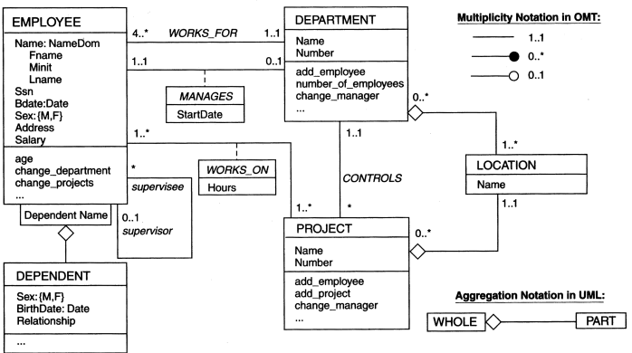
Data Model and Schema
ER diagram
(ER model)
Mini-world
(Data requirements)
Data modeling
(OO model)
class diagram
DB Schema
(DB structure)

Slide 7

Chapter Outline Concept Data Modeling Using Entities and Relationships
Example Database Application (COMPANY)
ER Model Concepts
Entities and Attributes
Entity Types, Value Sets, Key Attributes
Relationship Types
Weak Entity Types
Roles and Attributes in Relationship Types
ER Diagrams - Notation
Alternative Notations – UML class diagrams, others
Relationship Types of Degree Higher Than Two
Problem with ER data model

Slide 8
Example COMPANY Database
Requirements of the Company (oversimplified for illustrative purposes)
The company is organized into DEPARTMENTs.
Each department has a name, number and an employee who manages the department.
We keep track of the start date of the department manager.
Each department controls a number of PROJECTs.
Each project has a name, number and is located at a single location.
Mini World: Company
Construct DB
Design DB
Define DB
Load DB
DB
DBMS

Slide 9
Example COMPANY Database
We store each EMPLOYEE’s social security number, address, salary, sex, and birthdate.
Each employee works for one department but may work on several projects.
We keep track of the number of hours per week that an employee currently works on each project.
We also keep track of the direct supervisor of each employee.
Each employee may have a number of DEPENDENTs.
For each dependent, we keep track of their name, sex, birthdate, and relationship to employee.

Slide 10

ER diagram for the COMPANY DB
ER Model Concepts
Entities and Attributes
Entity Types, Value Sets, Key Attribute
Relationship Types
Weak Entity Types
Roles and Attributes in Relationship Types

Slide 11
ER Model Concepts
Entities
Entities are specific objects or things in the mini-world that are represented in the database.
the EMPLOYEE John Smith, the Research DEPARTMENT, the ProductX PROJECT
Attributes
Attributes are properties used to describe an entity.
an EMPLOYEE entity may have a Name, SSN, Address, Sex, BirthDate
A specific entity will have a value for each of its attributes.
a specific employee entity may have:
Name='John Smith', SSN='123456789', Address ='731, Fondren, Houston, TX', Sex='M', BirthDate='09-JAN-55‘
Each attribute has a value set (or data type) associated with it – e.g. integer, string, subrange, enumerated type, …

Slide 12
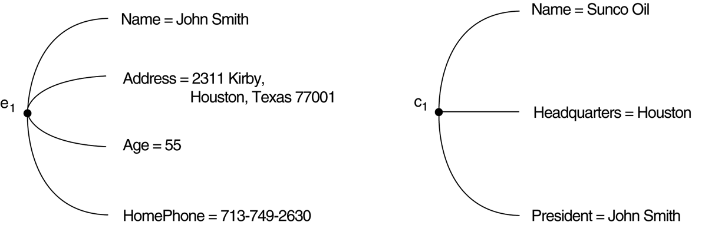
Two entities, employee e₁ and company c₁, and their attributes.

Slide 13
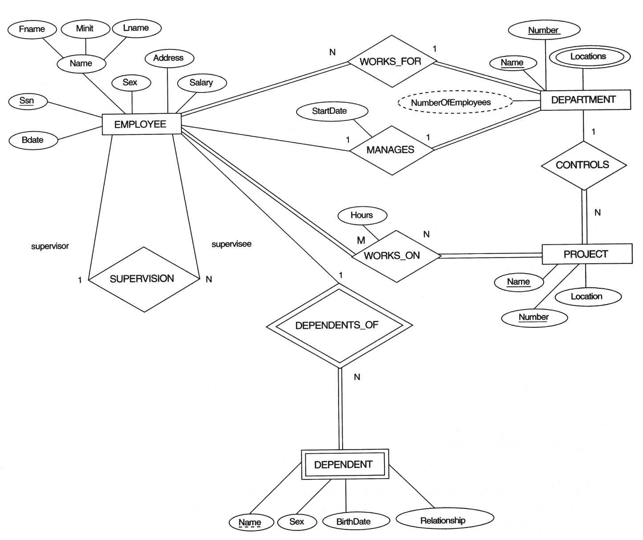
Types of Attributes (1)
Simple attributes
Each entity has a single atomic value for the attribute, e.g., SSN or Sex

Slide 14
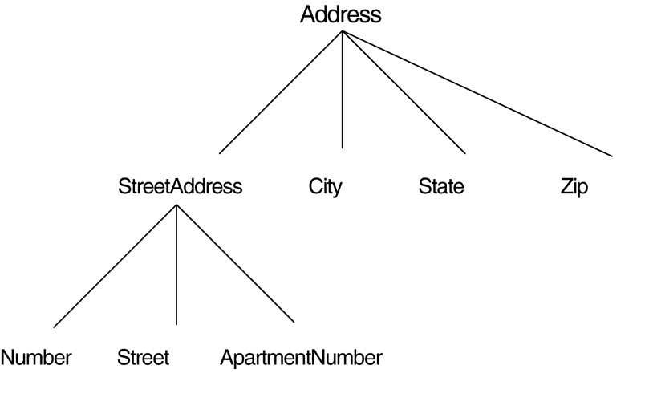
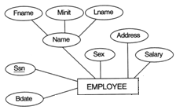
Types of Attributes (2)
Composite attributes
The attribute may be composed of several components.
e.g., Name(FirstName, MiddleName, LastName)
Composition may form a hierarchy where some components are themselves composite.
e.g., Address(StreetAddress(Number, Street, Apt#), City, State, Zip).
A hierarchy of composite attributes.

Slide 15
Types of Attributes (3)
Multi-valued
An entity may have multiple values for that attribute.
Color of a CAR: {Color}
PreviousDegrees of a STUDENT: {PreviousDegrees}.
Composite and multi-valued attributes may be nested arbitrarily to any number of levels although this is rare.
PreviousDegrees of a STUDENT is a composite multi-valued attribute denoted by
{ PreviousDegrees(College, Year, Degree, Field) }.

Slide 16
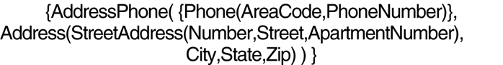
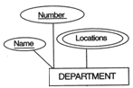
A complex attribute: AddressPhone.

Slide 17
Entity Types and Key Attributes
Entities with the same basic attributes are grouped or typed into an entity type.
the EMPLOYEE entity type or the PROJECT entity type.
An attribute of an entity type for which each entity must have a unique value is called a key attribute of the entity type.
SSN of EMPLOYEE.
A key attribute may be composite.
VehicleTagNumber is a key of the CAR entity type with components (Number, State).
An entity type may have more than one key.
the CAR entity type may have two keys:
VehicleIdentificationNumber (popularly called VIN) and
VehicleTagNumber (Number, State), also known as license_plate number.
EMPLOYEE
PROJECT
e1
p1
e8
p5

Slide 18
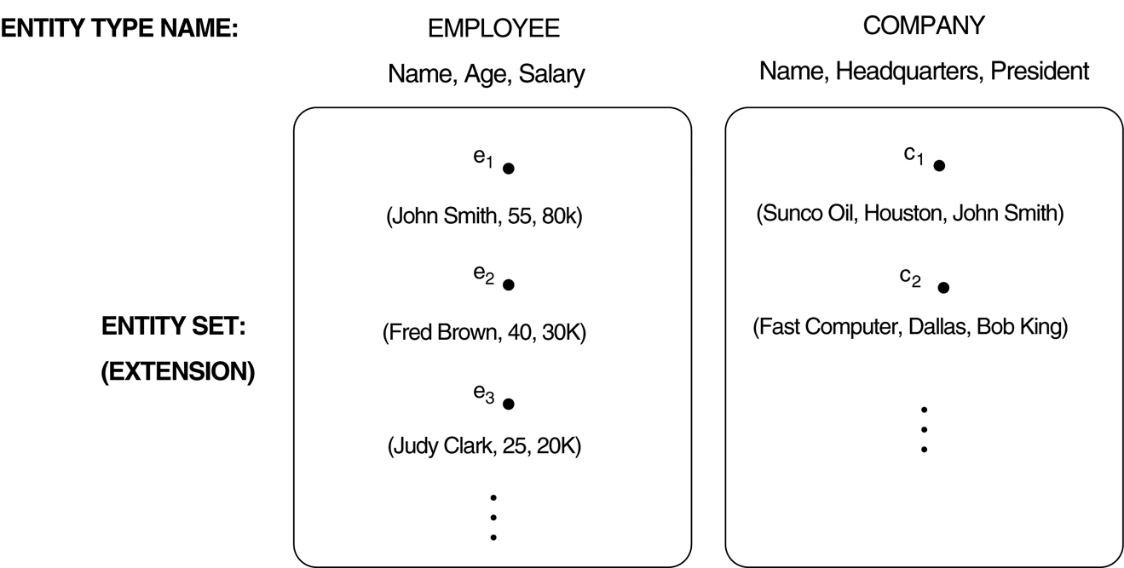
Two entity types, EMPLOYEE and COMPANY, and some member entities of each.

Slide 19
ENTITY SET corresponding to the ENTITY TYPE CAR
CAR
Registration(RegistrationNumber, State), VehicleID, Make, Model, Year, {Color}
car₁
((ABC 123, TEXAS), TK629, Ford Mustang, convertible, 1999, {red, black})
car₂
((ABC 123, NEW YORK), WP9872, Nissan 300ZX, 2-door, 2002, {blue})
car₃
((VSY 720, TEXAS), TD729, Buick LeSabre, 4-door, 2003, {white, blue})
.
.
.

Slide 20
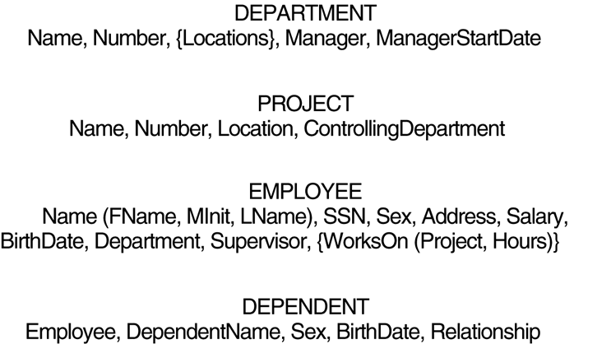
Preliminary design of entity types for the COMPANY database.

Slide 21

Entity Types: EMPLOYEE, DEPARTMENT, PROJECT, DEPENDENT

Slide 22
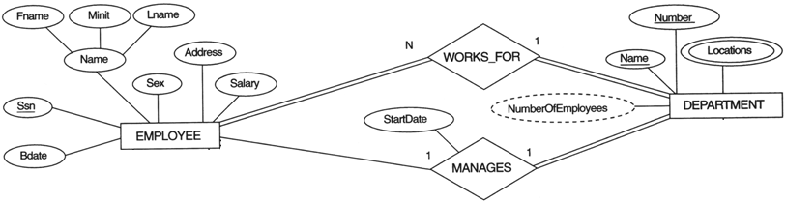
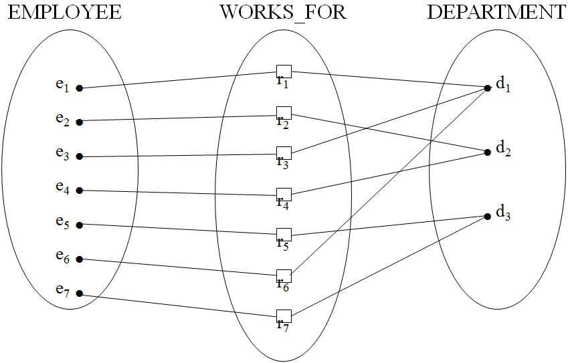
Relationships and Relationship Types (1)
A relationship relates two or more distinct entities with a specific meaning.
EMPLOYEE John Smith works on the ProductX PROJECT or EMPLOYEE Franklin Wong manages the Research DEPARTMENT.
Relationships of the same type are grouped or typed into a relationship type.
the WORKS_ON relationship type in which EMPLOYEEs and PROJECTs participate
the MANAGES relationship type in which EMPLOYEEs and DEPARTMENTs participate
The degree of a relationship type is the number of participating entity types.
Both MANAGES and WORKS_ON are binary relationships.

Slide 23
Relationship instances of the WORKS_FOR relationship between EMPLOYEE and DEPARTMENT

Slide 24
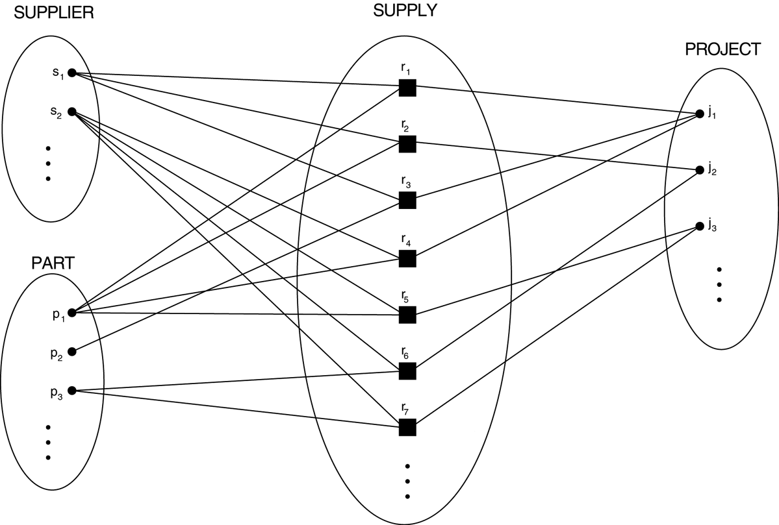
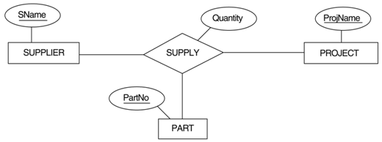
Some relationship instances in the SUPPLY ternary relationship set.
Degree of SUPPLY?

Slide 25

Number of Relationship Types with An Entity
More than one relationship type can exist with the same participating entity types.
MANAGES and WORKS_FOR are distinct relationships between EMPLOYEE and DEPARTMENT, but with different meanings and different relationship instances.

Slide 26
Relationship Types: WORKS_FOR MANAGES WORKS_ON CONTROLS SUPERVISION DEPENDENTS_OF

Slide 27
Weak Entity Type: DEPENDENT Partial Key: Name Identifying Relationship: DEPENDENTS_OF Identifying Entity Type: EMPLOYEE
哪個部門員工是主管
雙線: 不可以為0
Ex,每個員工至少參與一個案子
一個部門可多個專案
一個專案只屬一個部門
一個員工最多一個主管
一個主管多個下屬
雙線: 不可以為0
Ex,每個案子至少擁有一個員工
一個員工多個專案
一個專案可多個員工
不看這
看這
雙線: 不可以為0
Ex,員工不一定有眷屬
但一個眷屬至少對應一個employee
員工有多個眷屬
但一個眷屬可多個員工

Slide 28
Weak Entity Types
An entity that does not have a key attribute
A weak entity must participate in an identifying relationship type with an owner or identifying entity type
Entities are identified by the combination of:
A partial key of the weak entity type
The particular entity they are related to in the identifying entity type
Example:
Suppose that a DEPENDENT entity is identified by the dependent’s first name and birthdate, and the specific EMPLOYEE that the dependent is related to.
DEPENDENT is a weak entity type with EMPLOYEE as its identifying entity type via the identifying relationship type DEPENDENT_OF

Slide 29
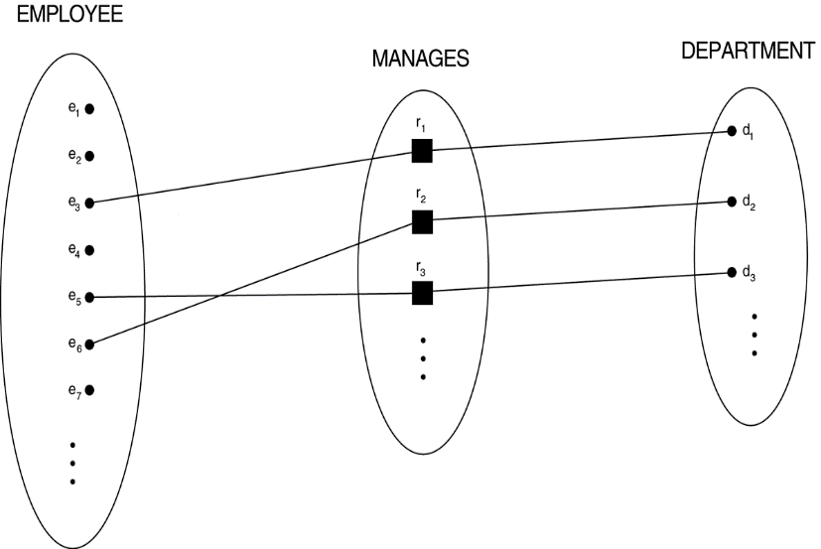
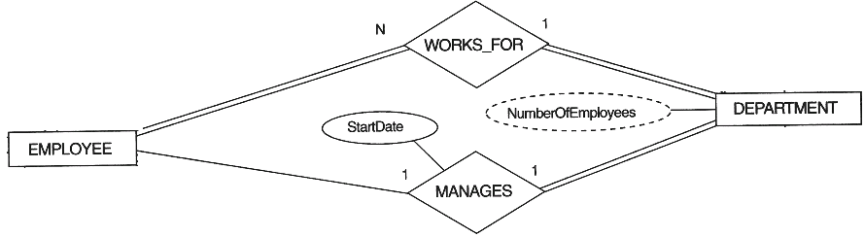
Constraints on Relationships
Constraints on Relationship Types
Maximum Cardinality (ratio constraints)
One-to-one (1:1)
One-to-many (1:N) or Many-to-one (N:1) #一個部門多個員工 一個員工可以多個部門
Many-to-many #多個員工可多個案子
Minimum Cardinality (participation & existence dependency constraints)
zero (optional participation, not existence-dependent) #單線 (不是每一個都要參與)
one or more (mandatory, existence-dependent) #雙線 (強制性,每個部門都要有主管)

Slide 30

A 1:1 relationship, MANAGES.
不是每個員工都要參與
每個部門一定要有主管

Slide 31
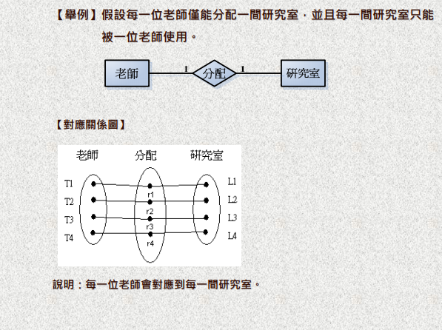

Slide 32
Many-to-One (N:1) RELATIONSHIP

Slide 33
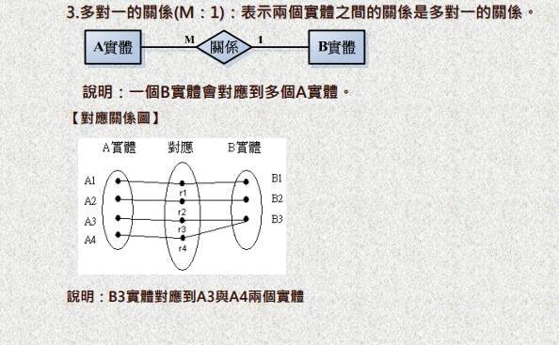

Slide 34
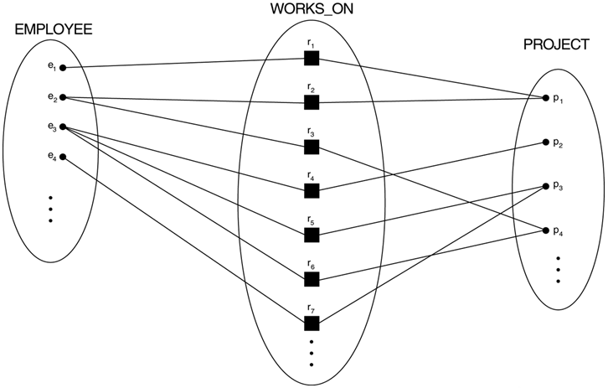
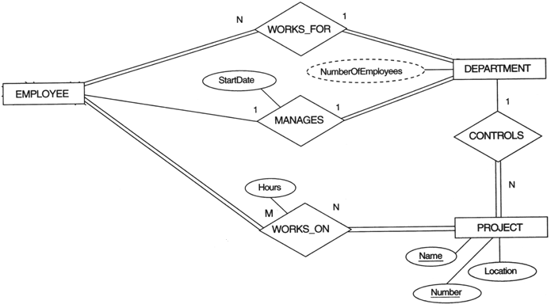
An M:N relationship, WORKS_ON.
員工至少參加一個(多個)案子

Slide 35
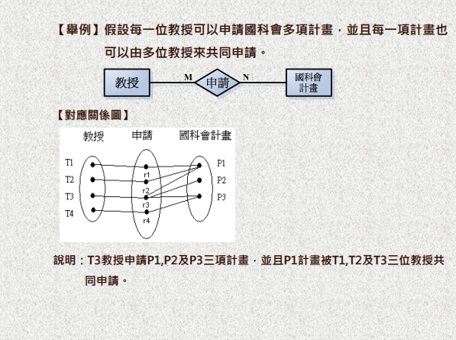

Slide 36
Recursive Relationship Types 遞歸
Recursive relationship types:
both participations are same entity type in different roles.
For example,
SUPERVISION relationships between EMPLOYEE (in role of supervisor or boss) and (another) EMPLOYEE (in role of subordinate or worker).
In following figure, first role participation labeled with 1 and second role participation labeled with 2.
In ER diagram, need to display role names to distinguish participations.

Slide 37
Recursive Relationship Type is: SUPERVISION (participation role names are shown)

Slide 38
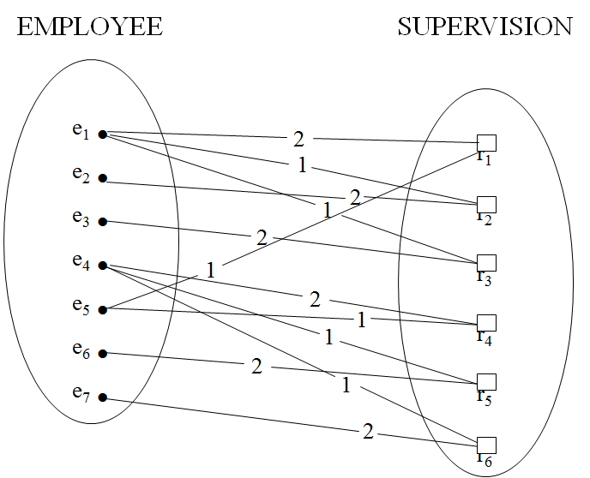
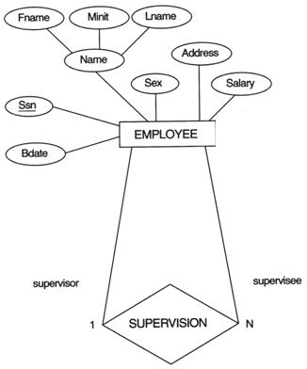
A RECURSIVE RELATIONSHIP SUPERVISION
Degree of SUPERVISION?

Slide 39

Attributes of Relationship Types
A relationship type can have attributes;
HoursPerWeek of WORKS_ON;
虛線: 衍生attribute
可以用SQL的COUNT去算
不必做成資料表 會麻煩
Ex,員工人數
Its value for each relationship instance describes the number of hours per week that an EMPLOYEE works on a PROJECT.
Name | Number | Location | DNO

Slide 40
Alternative (min, max) notation for relationship structural constraints:
Specified on each participation of an entity type E in a relationship type R
Specifies that each entity e in E participates in at least min and at most max relationship instances in R
Default(no constraint): min = 0, max = n
Must have min ≤ max, min ≥ 0, max ≥ 1
Derived from the knowledge of mini-world constraints
Examples:
A department has exactly one manager and an employee can manage at most one department.
Specify (0,1) for participation of EMPLOYEE in MANAGES
Specify (1,1) for participation of DEPARTMENT in MANAGES
An employee can work for exactly one department but a department can have any number of employees.
Specify (1,1) for participation of EMPLOYEE in WORKS_FOR
Specify (0,n) for participation of DEPARTMENT in WORKS_FOR

Slide 41
The (min,max) notation relationship constraints
員工最多管理一部門
否則最少管理零個Recursive relationship types:
部門最多一主管
最少一個主管
Employee
(0,1)
(1,1)
Manages
Department
員工最多一個部門
最少0個
部門有多個員工
最少一員工
(0,1)
(1,N)
Employee
Department
Works-for
(對面解讀)
一個最多屬一個部門
(對面解讀)
一個部門有多個員工
Employee
N
1
Works-for
Department

Slide 42
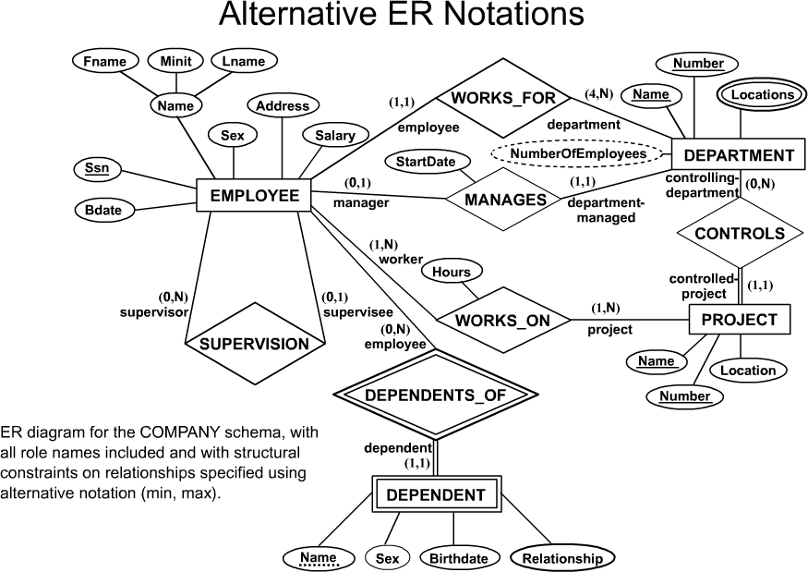
一個部門至少4到多個員工

Slide 43
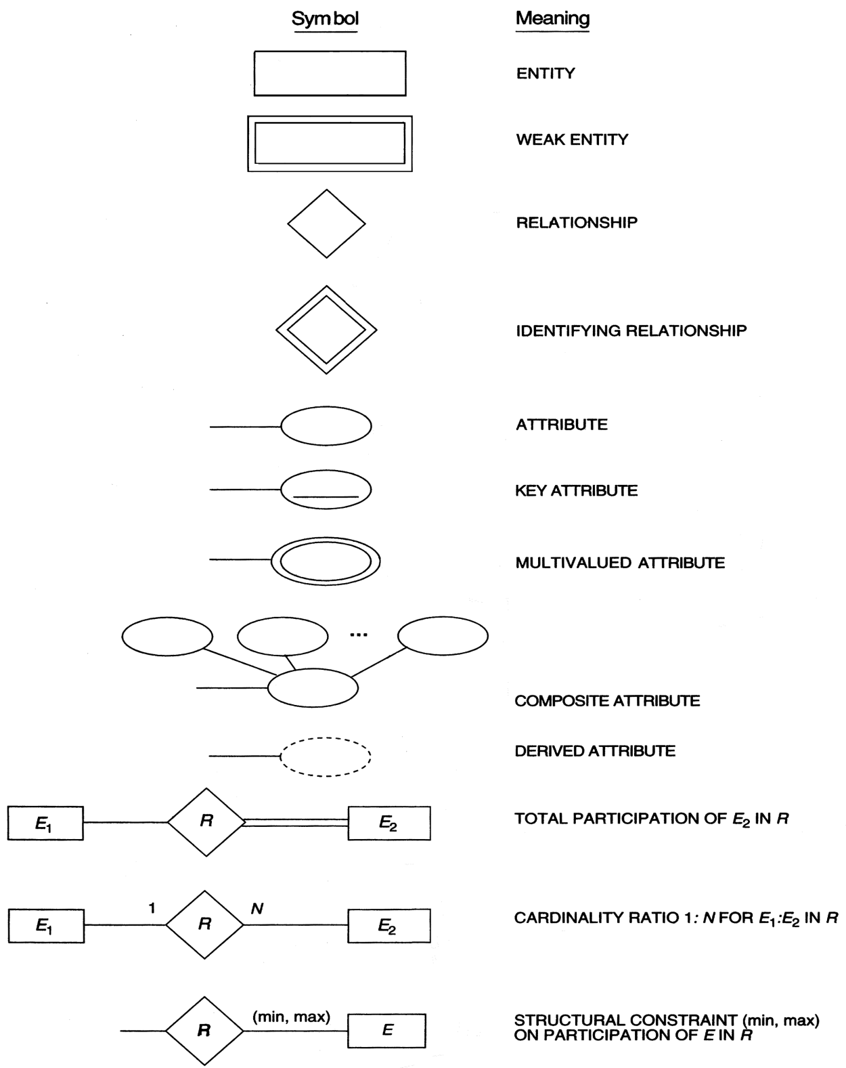
Summary of the notation for ER diagrams.

Slide 44

The COMPANY conceptual scheme in UML class diagram notation.

Slide 45
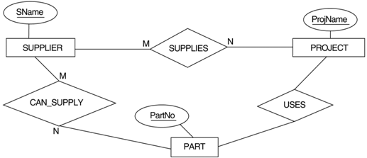
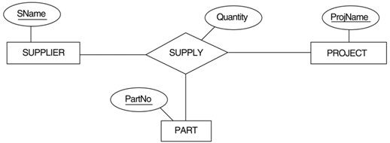
Relationships of Higher Degree
Relationship types of degree 2 are called binary
Relationship types of degree 3 are called ternary and of degree n are called n-ary
In general, an n-ary relationship is not Equivalent to n binary relationships
Equivalent?
不一樣

Slide 46
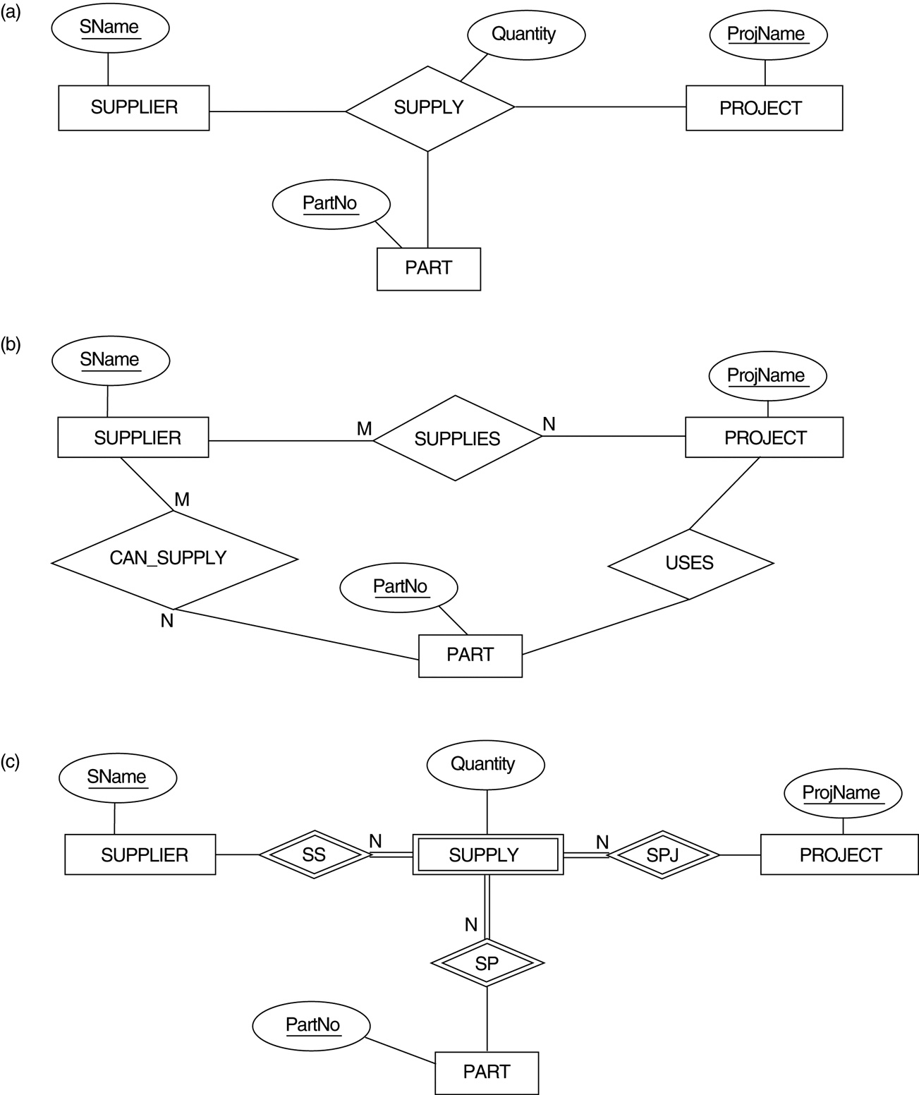
Ternary relationship types. (a) The SUPPLY relationship.
(b) Three binary relationships not equivalent to SUPPLY.
供應商
(c) SUPPLY represented as a weak entity type.

Slide 47
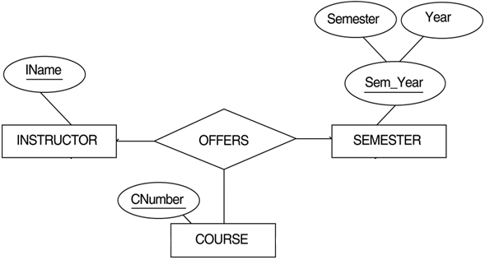
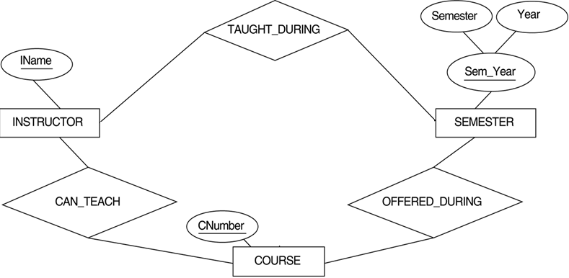
Another example of ternary versus binary relationship types

Slide 48
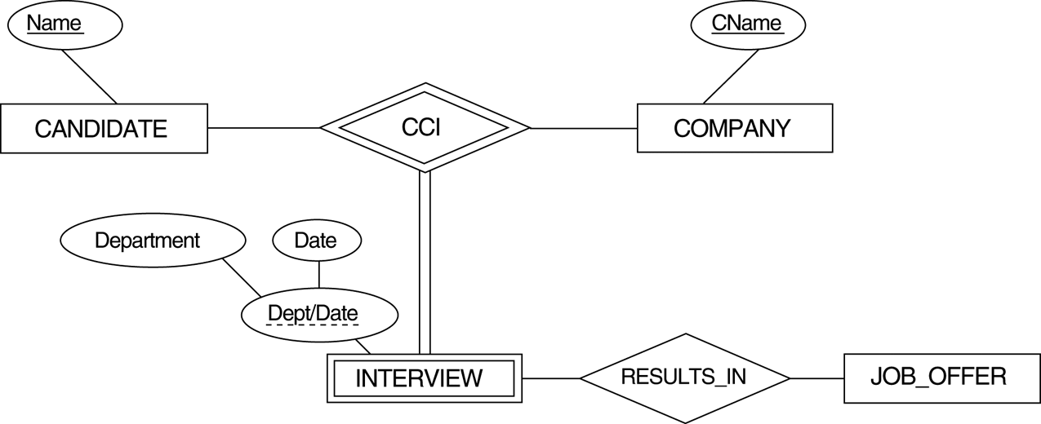
A weak entity type INTERVIEW with a ternary identifying relationship type.
到公司
誰
Jid
Position
(0,1)
(1,1)
參加interview
面試是否錄取
獲得什麼職位

Slide 49
PROBLEM with ER model
Problem with ER model
Did not support the specialization特殊化/ generalization一般化 abstractions
vehicle: car, truck, bus
employee: engineer, technician, secretary
teacher: professor, associate professor, assistance professor
Solution: EER (Enhanced/Extended ER Model) 加強型實體關係模型
Incorporates Set-subset relationships
Incorporates Specialization/Generalization Hierarchies
沿用所有的實體關係模型的觀念
• Superclass&Subclass 將某些實體類別更進一步地區分成若干個有意義的子群組
• Specialization 將一個Superclass區分成數個Subclass的過程
• Generalization 將擁有共同特徵的數個Subclass聚合成一個Superclass

Slide 50
Chapter 7 (Part 2) The Enhanced Entity-Relationship Model

Slide 51
A simplified diagram to illustrate the main phases of database design.
Construct DB
Design DB
Define DB
Load DB
Mini-world
DB
DBMS

Slide 52


Conceptual Design
Entity
Attribute
Relationship
…
(data model)
ER or OO
ER diagram
Mini-world
Data modeling
identify entities
identify relationships
include attributes and key
impose constraints
class diagram
Conceptual Schema
(DB structure)

Slide 53
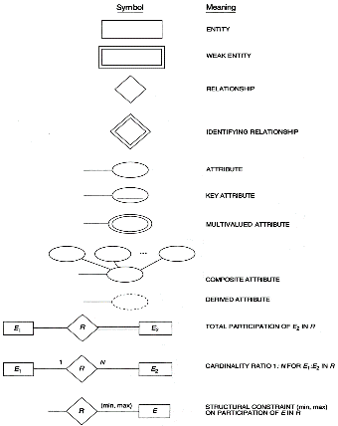
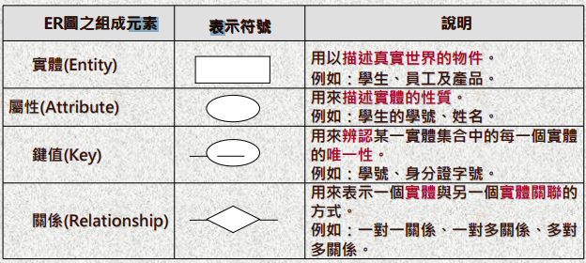
Summary of the notation for ER diagrams.
Problem with ER model
Did not support the specialization/generalization (subclass/class) abstractions
E.g., an engineer, a secretary or a technician is an employee.

Slide 54
Outline: Enhanced ER and UML Modeling
Subclasses, superclasses, and inheritance
Specialization and generalization
Constraints and characteristics of specialization and generalization
Modeling of UNION types using categories
An example UNIVERSITY EER schema
Formal definitions for the EER model
UML modeling

Slide 55
Enhanced-ER (EER) Model Concepts
Includes all modeling concepts of basic ER
Additional concepts:
subclasses/superclasses,
specialization/generalization,
categories,
attribute inheritance
Called the enhanced-ER or Extended ER (E2R or EER) model
Used to model applications more completely and accurately if needed
Includes some object-oriented concepts, such as inheritance

Slide 56
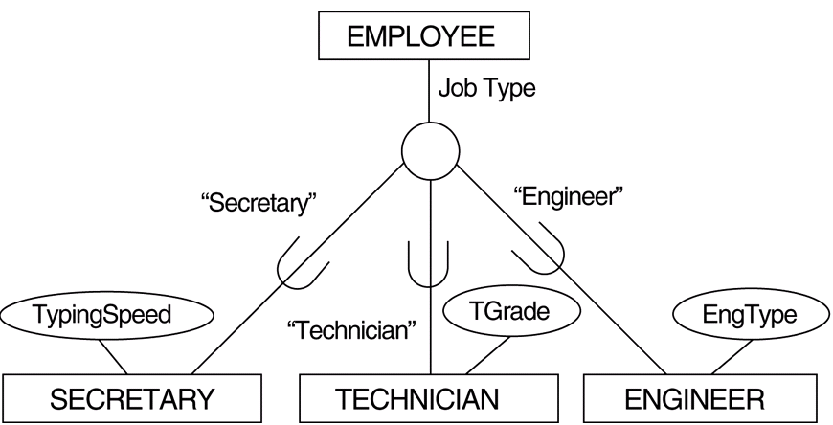
Subclasses and Superclasses
An entity type may have additional meaningful subgroupings of its entities
EMPLOYEE may be further grouped into
SECRETARY, ENGINEER, TECHNICIAN
MANAGER
SALARIED_EMPLOYEE, HOURLY_EMPLOYEE
Each is called a subclass of EMPLOYEE
EMPLOYEE is the superclass for each of these subclasses
Superclass/subclass relationships.
EMPLOYEE/SECRETARY
EMPLOYEE/TECHNICIAN
Also called IS-A relationships
SECRETARY IS-A EMPLOYEE
TECHNICIAN IS-A EMPLOYEE
superclass
d
subclasses

Slide 57
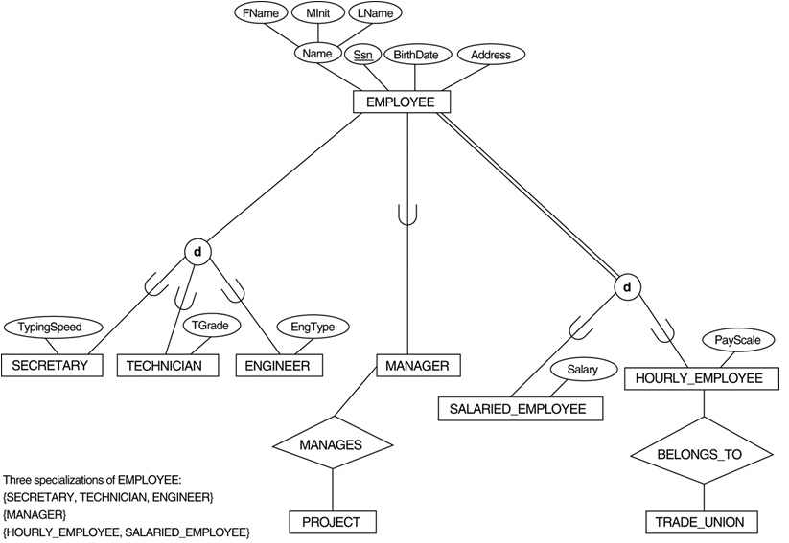
EER diagram notation to represent subclasses and specialization.
A member of the superclass can be optionally included as a member of any number of its subclasses.
E.g., A salaried employee who is also an engineer belongs to the two subclasses ENGINEER and SALARIED_EMPLOYEE
An entity that is member of a subclass inherits all attributes of the entity as a member of the superclass
It also inherits all relationships

Slide 58
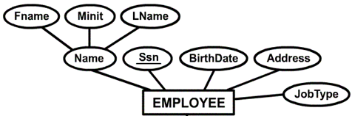
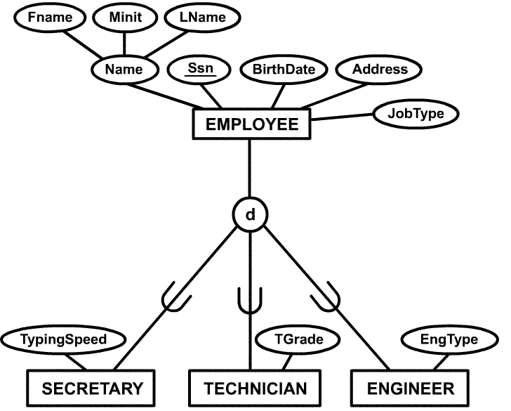
Example of a Specialization
Specialization:
the process of defining a set of subclasses of a superclass

Slide 59
Specialization
The set of subclasses is based upon some distinguishing characteristics of the entities in the superclass
May have several specializations of the same superclass
{SECRETARY, ENGINEER, TECHNICIAN} is a specialization of EMPLOYEE based upon job type.
Another specialization of EMPLOYEE based in method of pay is {SALARIED_EMPLOYEE, HOURLY_EMPLOYEE}.
Attributes of a subclass are called specific attributes.
TypingSpeed of SECRETARY
The subclass can participate in specific relationship types.
BELONGS_TO of HOURLY_EMPLOYEE
d

Slide 60
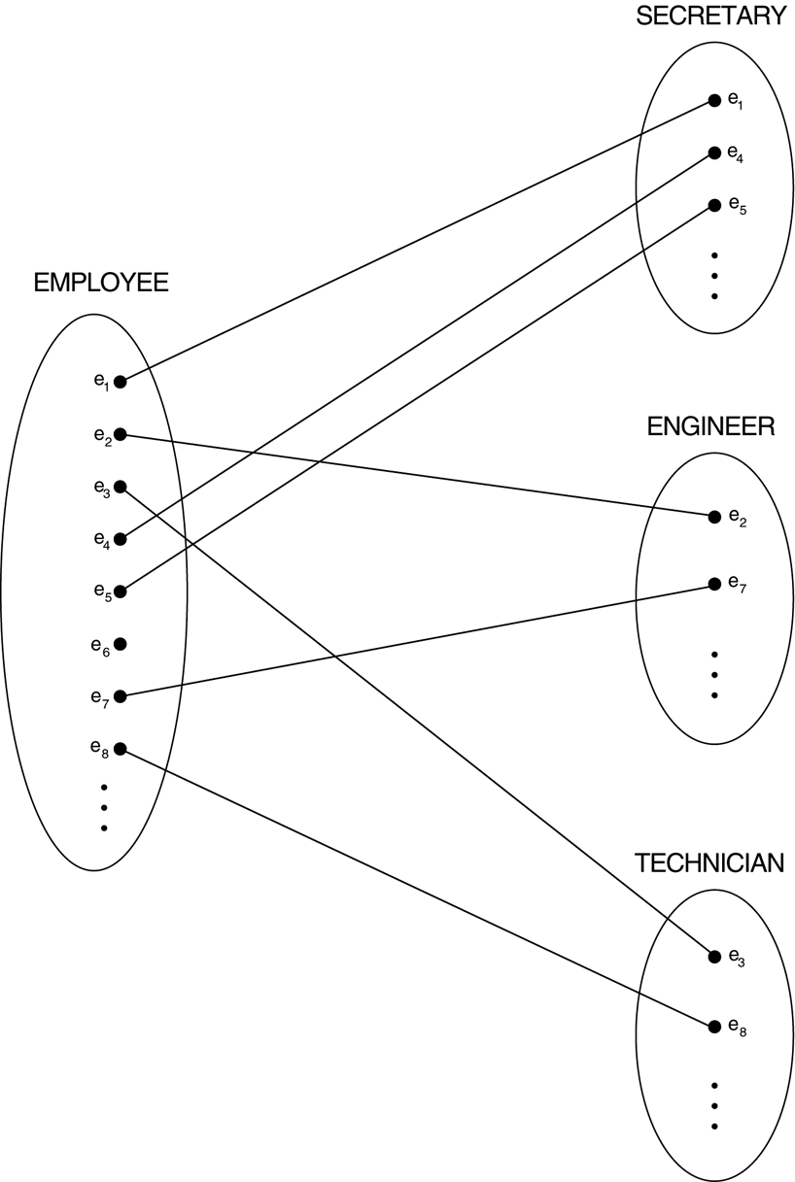
Instances of a specialization.
An entity that is member of a subclass represents the same real-world entity as some member of the superclass.
Not necessary that every entity in a superclass be a member of some subclass, e.g., e₆.

Slide 61
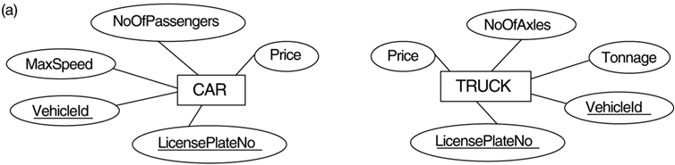
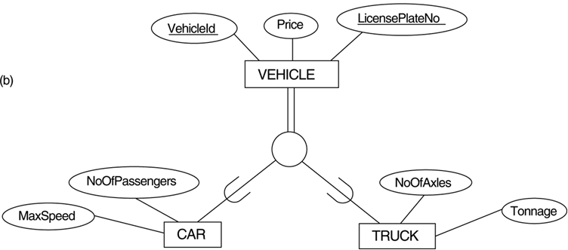
Generalization. (a) Two entity types, CAR and TRUCK. (b) Generalizing CAR and TRUCK into the superclass VEHICLE.
Generalization:
The process of generalizing several classes with common features into a superclass
d

Slide 62
Generalization
The reverse of the specialization process
The process of generalizing several classes with common features into a superclass;
Original classes become its subclasses
CAR, TRUCK generalized into VEHICLE; both CAR, TRUCK become subclasses of the superclass VEHICLE.
We can view {CAR, TRUCK} as a specialization of VEHICLE
we can view VEHICLE as a generalization of CAR and TRUCK

Slide 63
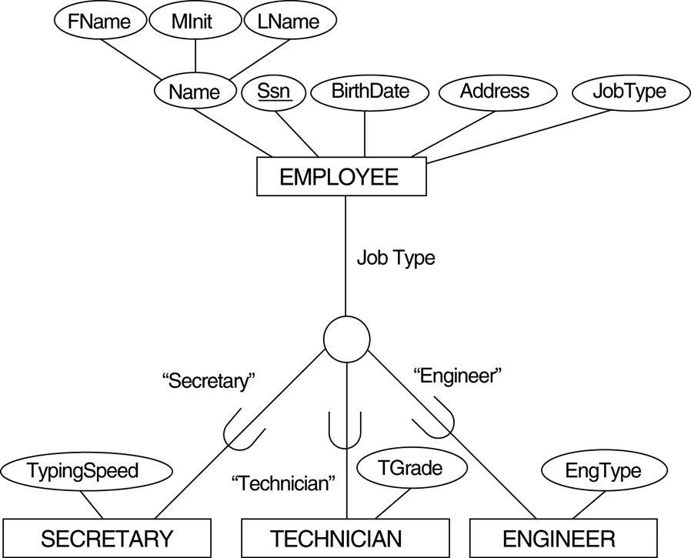
EER diagram notation for an attribute-defined specialization on JobType.
d

Slide 64
Constraints on Specialization and Generalization
Predicate-defined: If we can determine exactly those entities that will become members of each subclass by a condition, the subclasses are called predicate-defined (or condition-defined) subclasses
Condition is a constraint that determines subclass members
Display a predicate-defined subclass by writing the predicate condition next to the line attaching the subclass to its superclass
Attribute-defined: If all subclasses in a specialization have membership condition on same attribute of the superclass, specialization is called an attribute defined-specialization
Attribute is called the defining attribute of the specialization
JobType is the defining attribute of the specialization {SECRETARY, TECHNICIAN, ENGINEER} of EMPLOYEE
User-defined: If no condition determines membership, the subclass is called user-defined
Membership in a subclass is determined by the database users by applying an operation to add an entity to the subclass
Membership in the subclass is specified individually for each entity in the superclass by the user

Slide 65
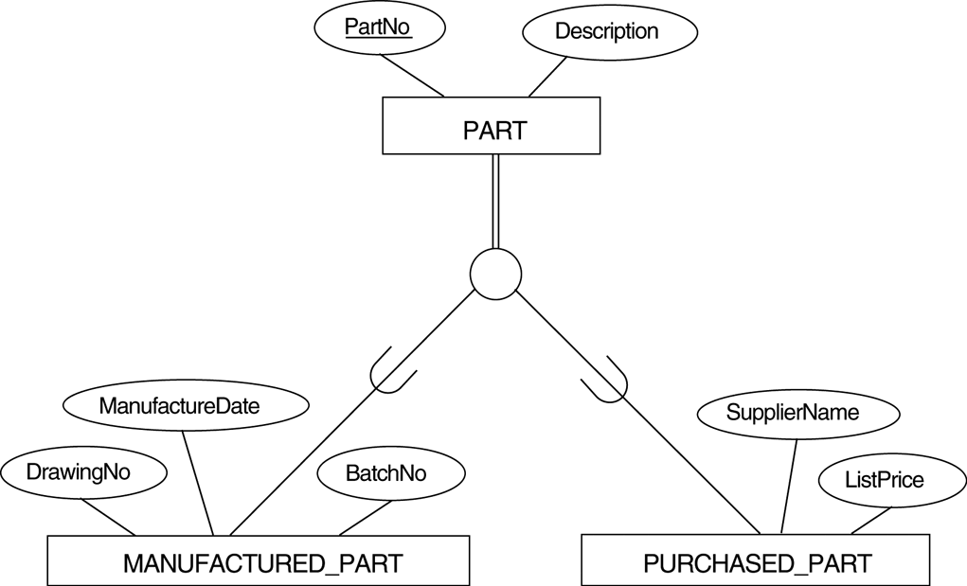
Disjointness and Completeness Constraints
Four types of specialization/generalization:
Disjoint, total (d, ||)
Disjoint, partial (d, |)
Overlapping, total (o, ||)
Overlapping, partial (o, |)
Note:
Generalization usually is total because the superclass is derived from the subclasses.
d
o
Disjoint, partial
Overlapping, total

Slide 66
Disjointness and Completeness Constraints
Disjointness Constraint:
Specifies that the subclasses of the specialization must be disjointed (an entity can be a member of at most one of the subclasses of the specialization)
Specified by d in EER diagram
If not disjointed, overlap; that is the same entity may be a member of more than one subclass of the specialization
Specified by o in EER diagram
Completeness Constraint:
Total specifies that every entity in the superclass must be a member of some subclass in the specialization/ generalization
Shown in EER diagrams by a double line (i.e., ||)
Partial allows an entity not to belong to any of the subclasses
Shown in EER diagrams by a single line (i.e., |)

Slide 67
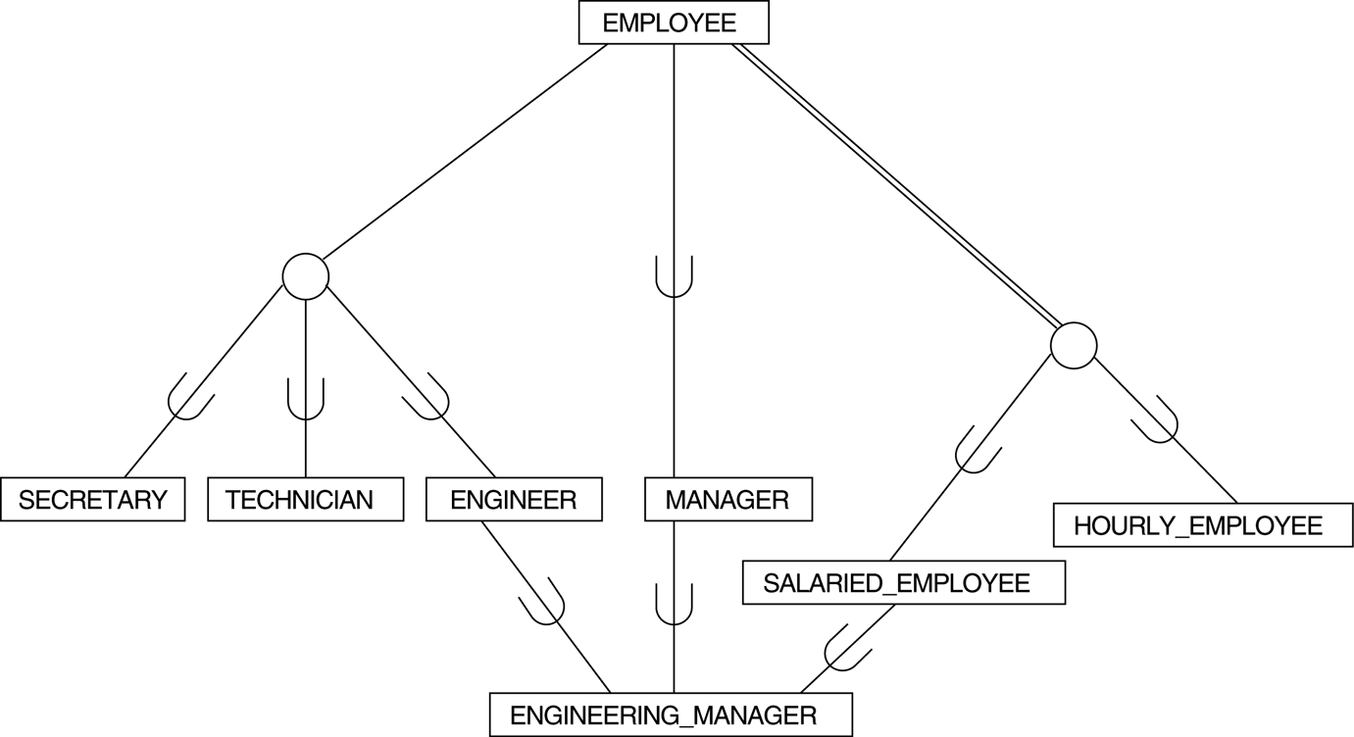
A specialization lattice with shared subclass ENGINEERING_MANAGER
A subclass with more than one superclass is called a shared subclass
d
d

Slide 68

Specialization / Generalization Hierarchies, Lattices and Shared Subclasses
A subclass may itself have further subclasses specified on it, forming a hierarchy or a lattice
In a lattice or hierarchy, a subclass inherits attributes not only of its direct superclass, but also of all its predecessor superclasses
Hierarchy has a constraint that every subclass has only one superclass
(called single inheritance)
In a lattice, a subclass can be subclass of more than one superclass
(called multiple inheritance)
d
d
d
Hierarchy
Lattice

Slide 69
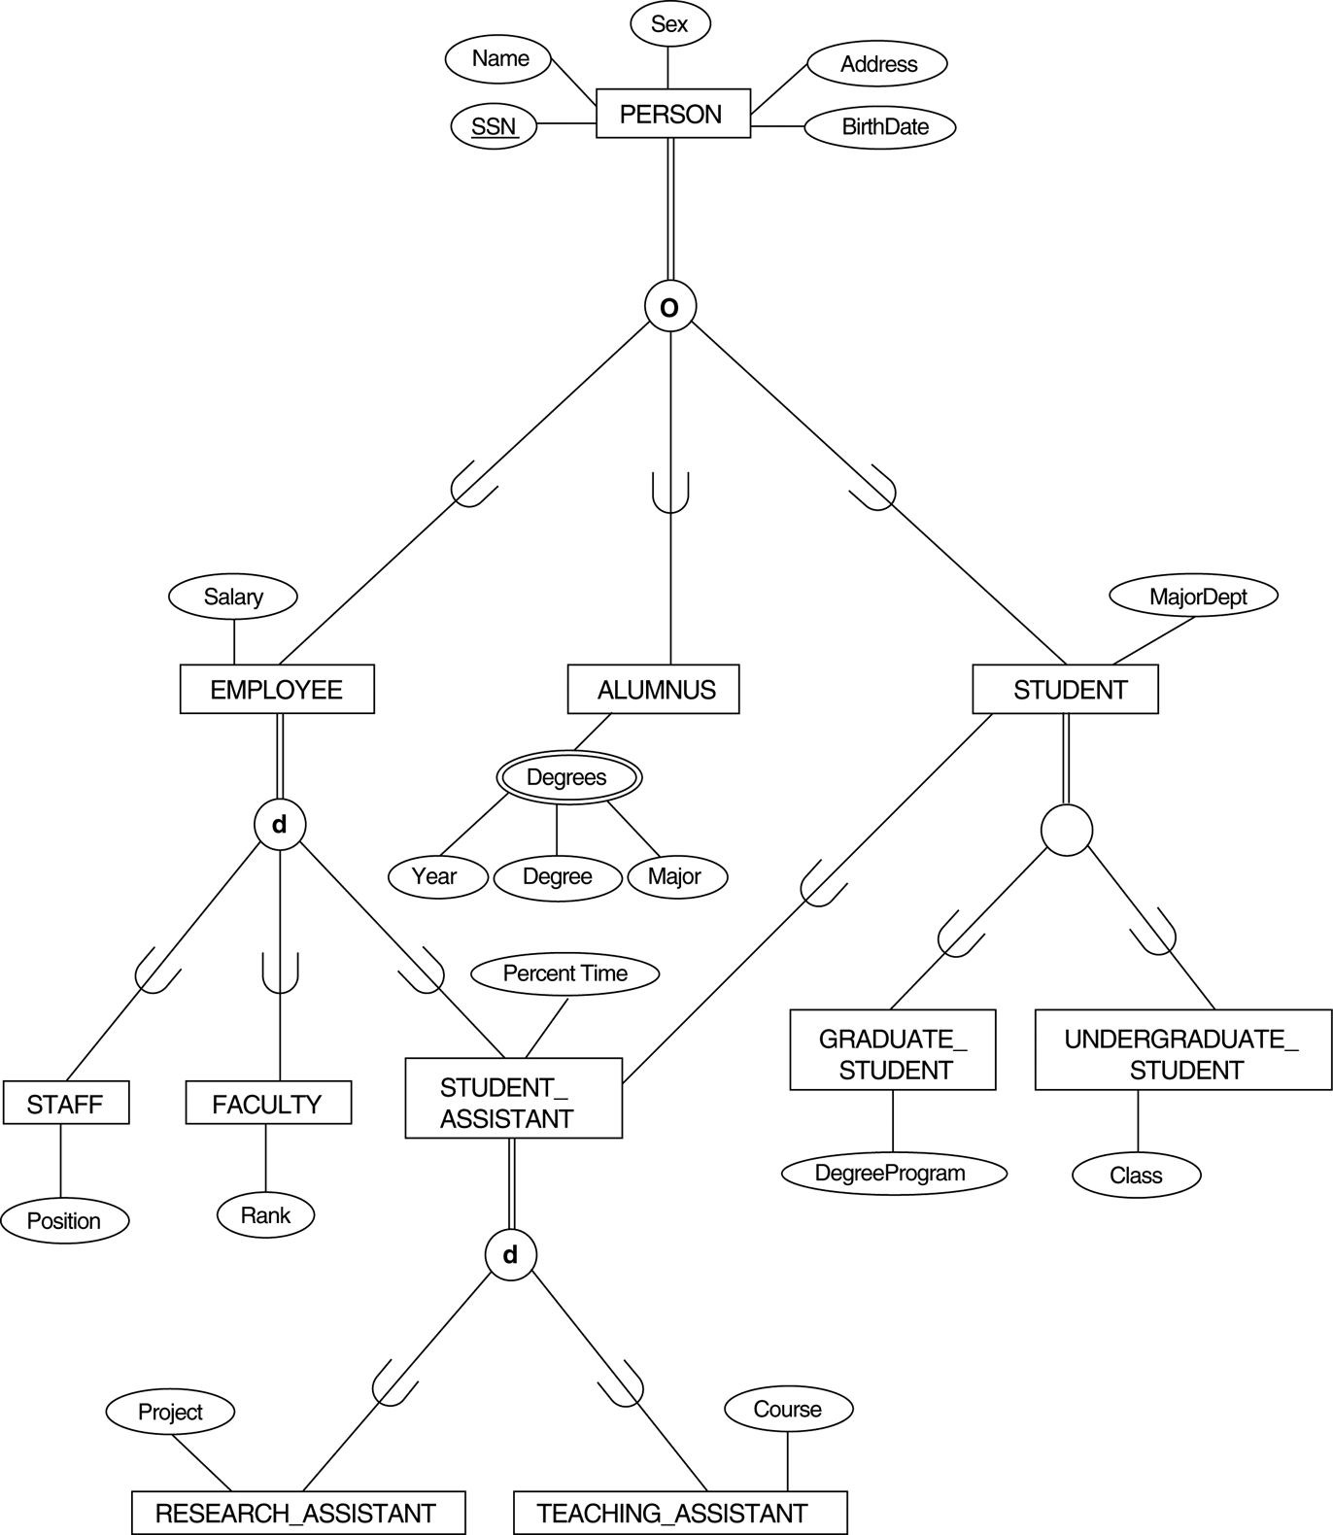
A specialization lattice with multiple inheritance for a UNIVERSITY database.
d

Slide 70
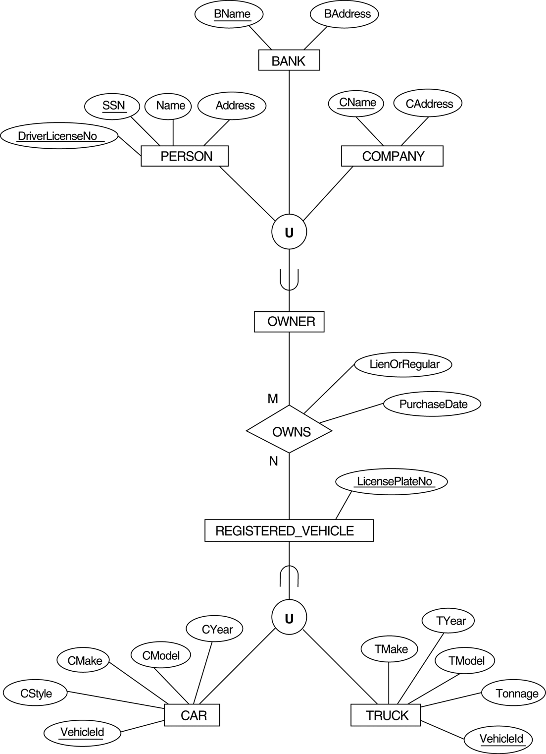

Two categories (union types): OWNER and REGISTERED_VEHICLE.
superclass
subclass
Shared class: each relationship has a single superclass.
Category (or union type)
A single superclass/subclass relationship with more than one superclass.
註冊的
subclass
superclass

Slide 71
Categories (UNION TYPES)
a single superclass/subclass relationship with more than one superclass
Superclasses represent different entity types
Such a subclass is called a category or UNION TYPE
Database for vehicle registration, vehicle owner can be a person, a bank (holding a lien on a vehicle) or a company.
Category (subclass) OWNER is a subset of the union of the three superclasses COMPANY, BANK, and PERSON
A category member must exist in at least one of its superclasses
Note:
A shared subclass is subclass in more than one distinct superclass/subclass relationships, where each relationships has a single superclass (multiple inheritance)
Shared subclass is a subset of the intersection of its superclasses
A shared subclass member must exist in all of its superclasses.

Slide 72
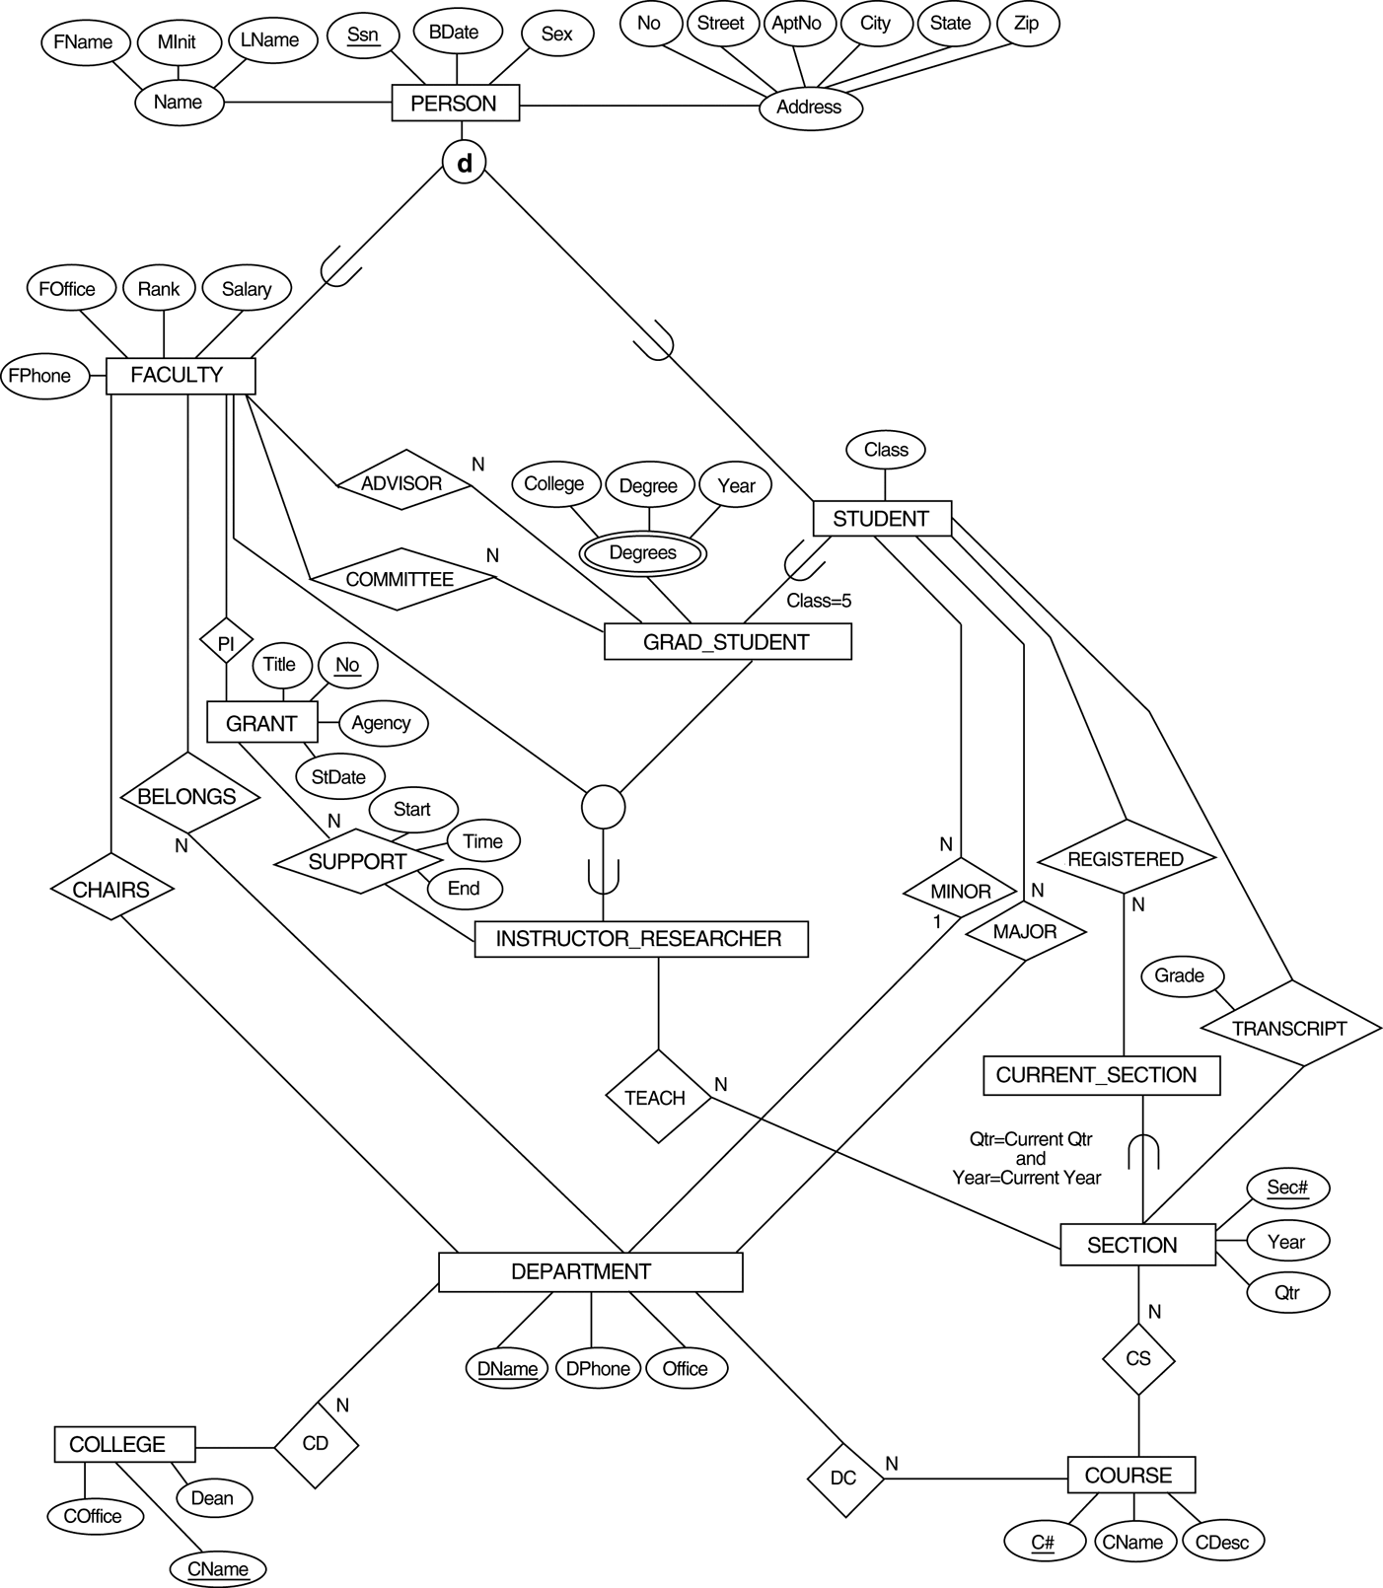
An EER conceptual schema for a UNIVERSITY database.
U

Slide 73
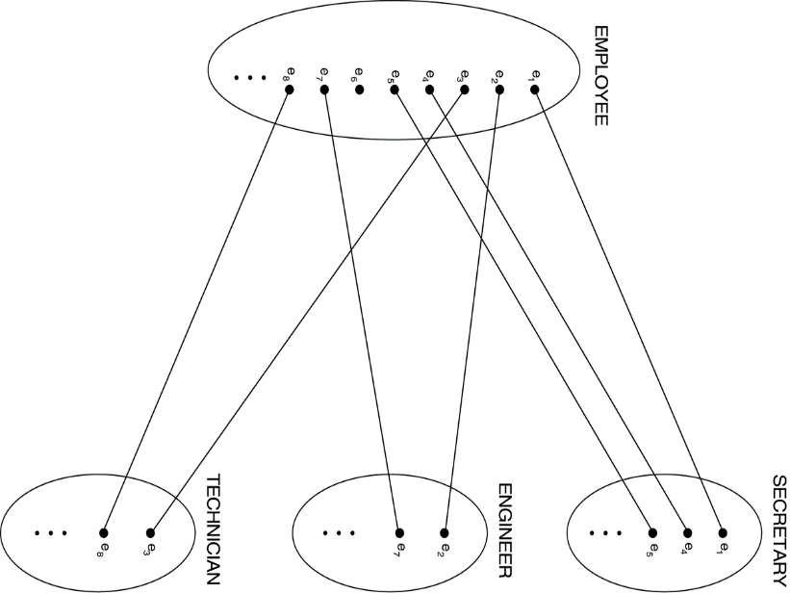
Formal Definitions of EER Model (1)
Class C:
A set of entities; could be entity type, subclass, superclass, category.
Subclass S:
A class whose entities must always be subset of the entities in another class, called the superclass C of the superclass/subclass (or IS-A) relationship S/C:
S ⊆ C
Specialization Z:
Z = {S₁, S₂,…, S_{n}} a set of subclasses with same superclass G; hence, G/S_{i} a superclass relationship for i = 1, …., n.
G is called a generalization of the subclasses {S₁, S₂,…, S_{n}}
Z is total if we always have:
S₁ ∪ S₂ ∪ … ∪ S_{n} = G; Otherwise, Z is partial.
Z is disjoint if we always have:
S_{i} ∩ S_{j} is an empty-set for i ≠ j;
Otherwise, Z is overlapping.
G
S₁
…
S_{n}

Slide 74
Formal Definitions of EER Model (2)
Subclass S of C is predicate defined
if predicate p on attributes of C is used to specify membership in S; that is, S = C[p], where C[p] is the set of entities in C that satisfy p
A subclass not defined by a predicate is called user-defined
Attribute-defined specialization:
if a predicate A = c_{i} (where A is an attribute of G and c_{i} is a constant value from the domain of A) is used to specify membership in each subclass S_{i} in Z
Note: If c_{i} ≠ c_{j} for i ≠ j, and A is single-valued, then the attribute-defined specialization will be disjoint.
d
ENGINEER =
EMPLOYEE[JobType = “Engineer”]

Slide 75
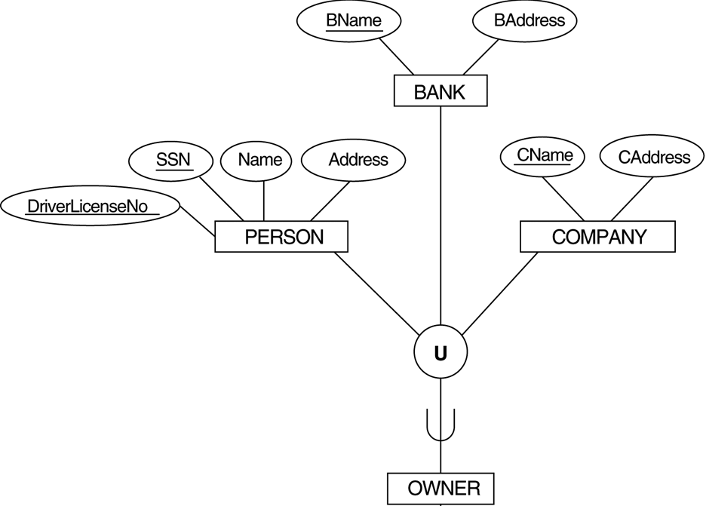
Formal Definitions of EER Model (3)
Category or UNION type T
A class that is a subset of the union of n defining superclasses D₁, D₂,…D_{n}, n > 1:
T ⊆ (D₁ ∪ D₂ ∪ … ∪ D_{n}) A predicate p_{i} on the attributes of T.
If a predicate p_{i} on the attributes of D_{i} can specify entities of D_{i} that are members of T.
If a predicate is specified on every D_{i}: T = (D₁[p₁] ∪ D₂[p₂] ∪…∪ D_{n}[p_{n}])
Note: The definition of relationship type should have 'entity type' replaced with 'class'.
D₂
D₁
D₃
T =
(PERSON[DriverLicenseNo ≠ NULL] ∪…)
T

Slide 76
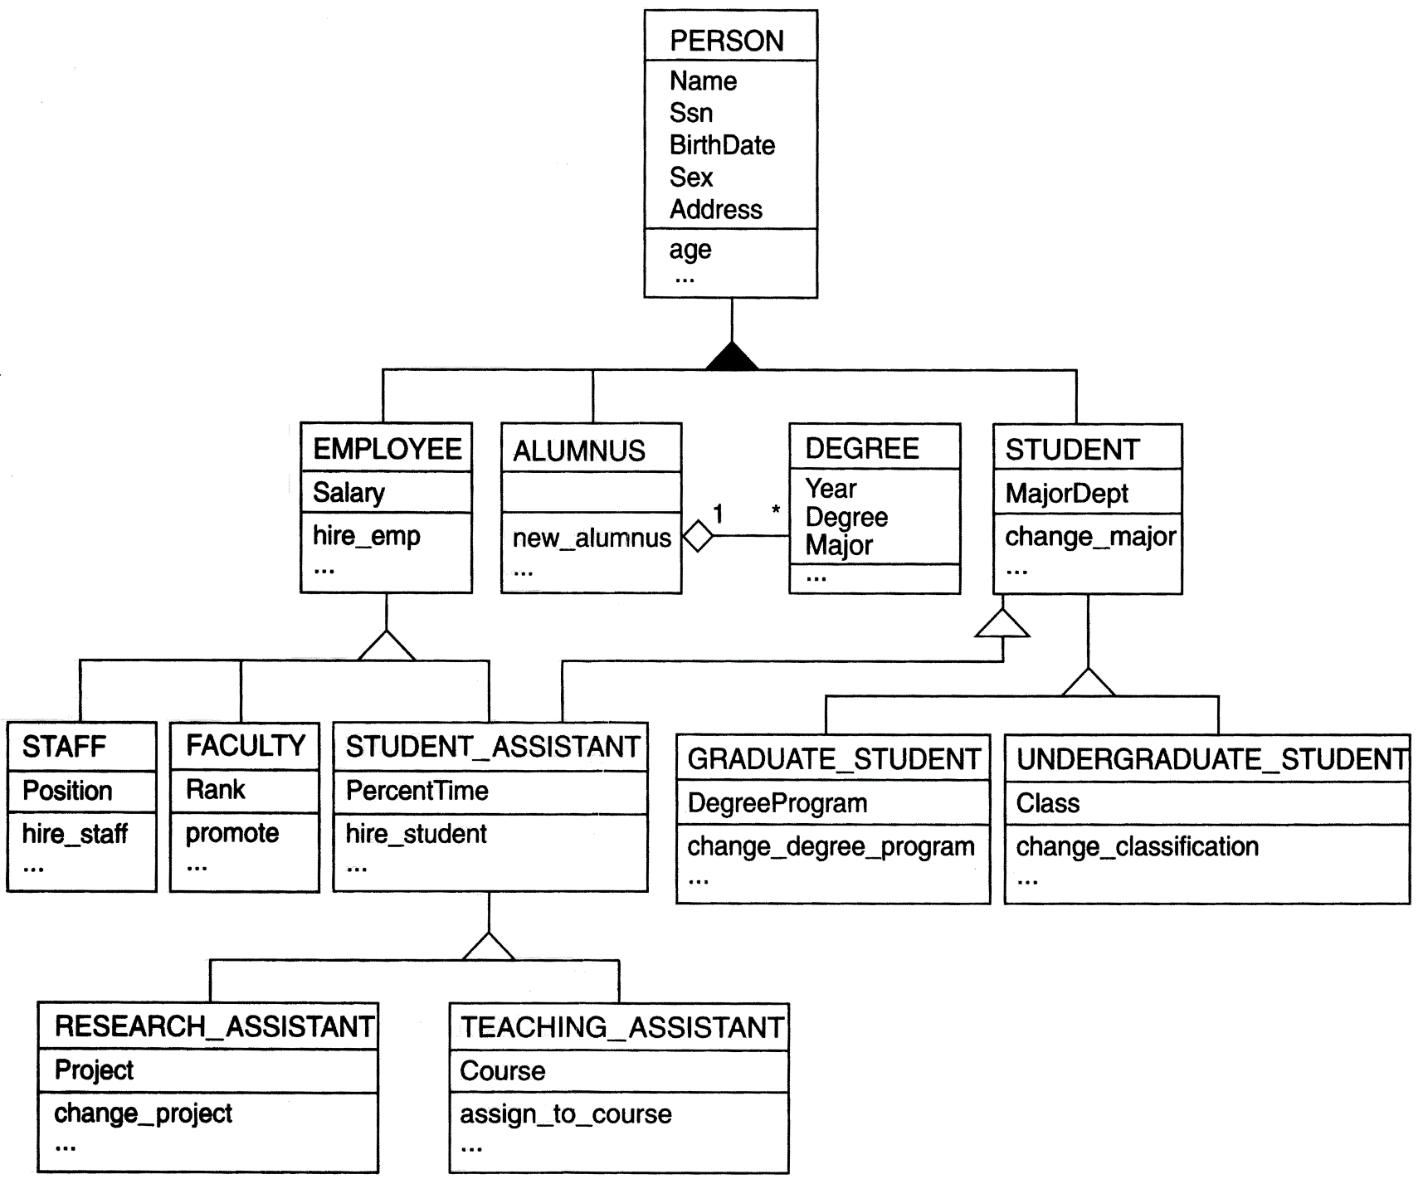
A UML class diagram corresponding to the EER, illustrating UML notation for specialization/generalization.

Slide 77





Alternative Diagrammatic Notations
Symbols for entity type / class, attribute and relationship
Displaying attributes
Notations for displaying specialization / generalization
Various (min, max) notations
Displaying cardinality ratios

